Slide 1
Agentic AI System Project
Student: Saud Ur-Rehman
Institute: Dice Analytics

Slide 2
Project Goals
01
Professional Project Setup
02
Local LLM Setup
03
SQLite with Vector Database setup
04
Streamlit with Langflow setup

Slide 3
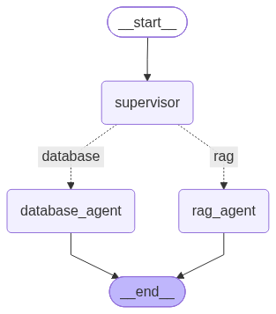
State Graph

Slide 4
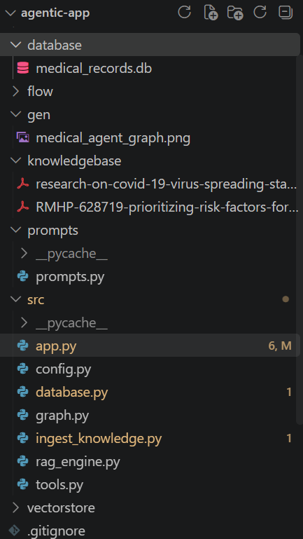
1. Professional Project Structure

Slide 5
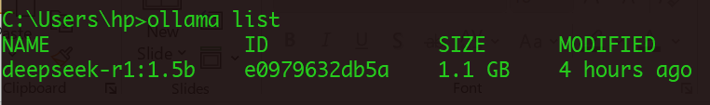
2. Local LLM with Ollama

Slide 6
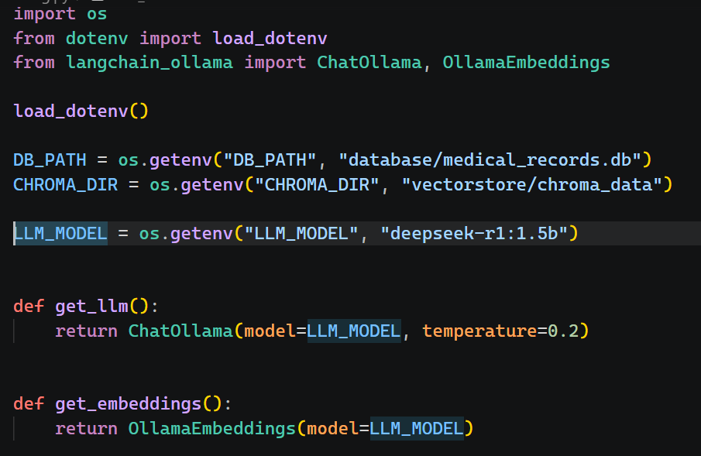
2. Local LLM with Ollama

Slide 7
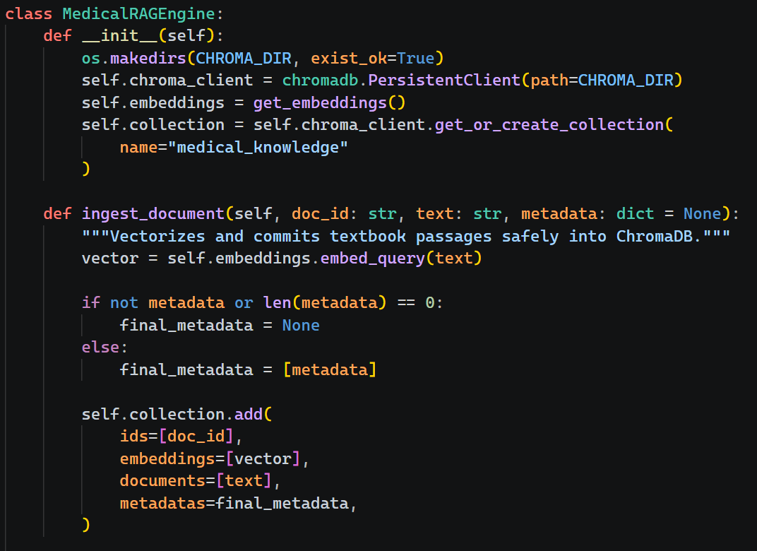
3. Vector DB

Slide 8
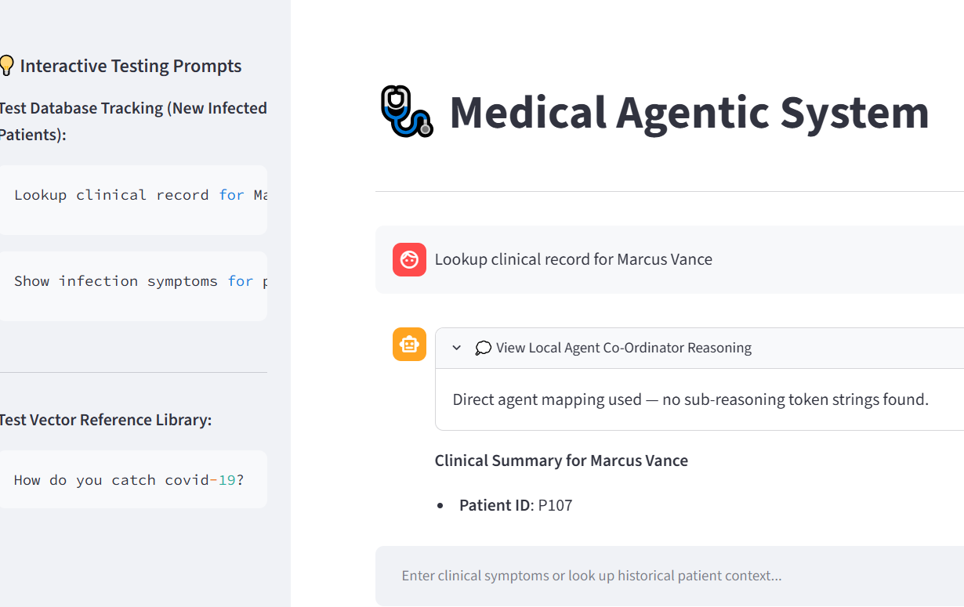
4. Streamlit UI

Slide 9
Commands

Slide 10
Project Commands
Commands
uv run python -m src.ingest_knowledge
uv run python graph_gen.py
uv run streamlit run src/app.py
uvx langflow run --host 127.0.0.1 --port 7860

Slide 11
Working Demo

Slide 12
GitHub Repository
https://github.com/saud4041/medical-agentic-system

Slide 13
Further Improvements

Slide 14
Further Improvements
1. Cloud based LLM like ChatGPT
2. Caching & Rate Limiting
3. FastAPI & NextJS Integration
4. Pg_Vector with PostgreSQL RDBMS
5. Agent Harness & Agentic RAG
6. MCP & A2A
7. Eval and Monitoring
8. ReACT
Improvements

Slide 15
Q&A Session

